Slide 1

BCSE497J - Project-I

Slide 2
TOPIC
REAL-TIME VIOLENCE DETECTION USING VIDEO DATASET

Slide 3
UNDER THE GUIDANCE OF
Dr MANOOV R
Assistant Professor Senior,
Department of IoT,
SCOPE,
VIT University.

Slide 4
TEAM DETAILS
21BCE0818 - TANYA BATRA
21BCE3826 - ADITYA JHA
21BCE0545 - ARYAN KHATUWALA

Slide 5
ABSTRACT
Violence detection in real-time video streams is a critical task with applications in public safety, surveillance, and law enforcement. Traditional surveillance systems rely heavily on human observation, making them prone to errors and delays in response. To overcome these limitations, we propose a deep learning-based approach that leverages a combination of Convolutional Neural Networks (CNN) and Long Short-Term Memory (LSTM) models to detect violent behavior in video sequences. Additionally, the MobileNet architecture is integrated to enhance real-time performance on edge devices due to its lightweight and computationally efficient nature.

Slide 6
AIM
To develop a real-time violence detection system using a combination of Convolutional Neural Networks (CNN), Long Short-Term Memory (LSTM) networks, and MobileNet architecture, enabling efficient and accurate identification of violent activities in video streams.

Slide 7
OBJECTIVES
Design and Implement CNN Model: Develop a Convolutional Neural Network to extract spatial features from individual video frames, focusing on patterns indicative of violent behavior.
Integrate LSTM for Temporal Analysis: Implement Long Short-Term Memory networks to analyze temporal dependencies across video frames, enabling the detection of violent activities over time.
Optimize with MobileNet: Utilize MobileNet to ensure the model operates efficiently on resource-constrained devices, supporting real-time processing and deployment.
Train and Evaluate on Video Dataset: Train the integrated model on a publicly available video dataset, assessing its performance in detecting violence with high accuracy and low latency.
Deploy and Test in Real-Time: Deploy the model in a real-time environment, testing its effectiveness in practical surveillance scenarios and ensuring it meets performance requirements.

Slide 8
BACKGROUND
The videos obtained from surveillance cameras are of low resolution, i.e. low accuracy.
The objects in the outdoor surveillance are often in the far field and the front view would not be available always, i.e. less features.
Most of the works in violence recognition were on artificially created datasets.
Most of the approaches are not for low end devices like smartphones, CCTV systems etc.

Slide 9
PROJECT GOALS
Address Research Gaps: Identify and overcome limitations from existing studies, including issues with accuracy, computational efficiency, and adaptability.
Design for Low-End Devices: Create a solution optimized for performance on devices with constrained resources.
Achieve Reliable Detection: Develop a system that minimizes errors and delivers consistent, accurate results.
Adapt to Real-World Conditions: Ensure the system effectively handles a variety of real-life scenarios and environments.

Slide 10
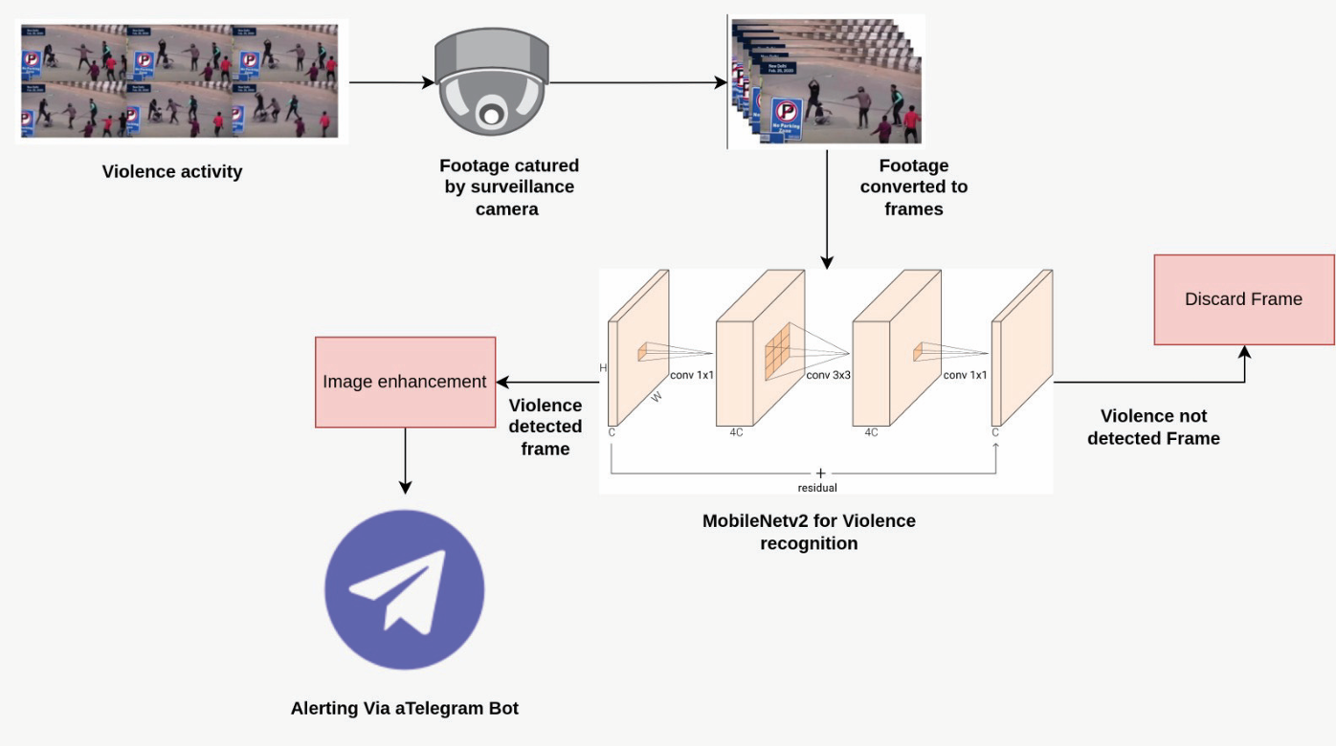
METHODOLOGY

Slide 11
1. The implementation of the real-time violence detection system starts by gathering a comprehensive video dataset with labeled instances of violent and non-violent activities.
2. Preprocess the data through normalization, resizing, and augmentation to ensure consistency and robustness.
3. Develop the model architecture by constructing a Convolutional Neural Network (CNN) to extract spatial features from individual frames, and integrate it with Long Short-Term Memory (LSTM) networks to analyze temporal dependencies across sequences.
4. Optimize the model using MobileNet to maintain efficiency and feasibility on resource-constrained devices.
5. Train the combined CNN-LSTM model, employing techniques like cross-validation to fine-tune hyperparameters and enhance performance metrics such as precision and recall.
6.Implement real-time video stream processing to ensure minimal latency.
7. Finally, deploy the system in practical settings, rigorously test it in diverse real-life scenarios, and continuously monitor and refine the system based on feedback and performance data.

Slide 12
1. Data Collection
Surveillance Footage: Collect video footage from surveillance cameras. This footage will serve as the input for the system.
2. Frame Extraction
Convert Video to Frames: Use a tool or script to extract individual frames from the video footage. This can be done using libraries like OpenCV in Python.
3. Image Enhancement
Enhance Frames: Improve the quality of the extracted frames using image processing techniques. This might include adjusting brightness, contrast, and removing noise.
4. Model Training
MobileNetV2: Train a MobileNetV2 model on a dataset of violent and non-violent activities. This involves:
Data Preparation: Label the frames as violent or non-violent.
Model Training: Use a deep learning framework like TensorFlow or PyTorch to train the MobileNetV2 model on the labeled data.

Slide 13
5. Violence Detection
Inference: Use the trained MobileNetV2 model to analyze each frame. The model will output whether the frame contains violence or not.
6. Alert System
Telegram Bot: If violence is detected, trigger an alert using a Telegram bot. This involves:
Bot Setup: Create a Telegram bot and get the API token.
Send Alert: Use the Telegram API to send a message to a predefined chat or group.
7. Discard Non-Violent Frames
Frame Discarding: If no violence is detected, discard the frame to save storage and processing power.

Slide 14
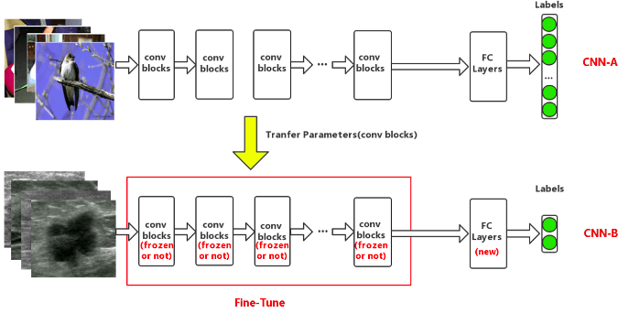
TRANSFER LEARNING
Transfer learning is a machine learning technique where a model pre-trained on a large,
general dataset, like ImageNet, is adapted to a new, smaller, specialized dataset.
This process involves reusing the convolutional layers of the pre-trained model, which have already learned to
extract useful features, and fine-tuning the final layers to suit the specific task. This approach significantly
reduces training time, improves performance, and is resource-efficient, making it particularly useful when the
new dataset is limited in size. For example, in a violence detection system, a pre-trained MobileNetV2 model
can be fine-tuned on a dataset of violent and non-violent activities to quickly and accurately identify violent
behavior in surveillance footage.

Slide 15
TECH STACK
MobilenetV2:
MobileNetV2 utilizes Convolutional Neural Networks (CNNs) through depthwise separable convolutions, which separate spatial and channel-wise processing to reduce computational load. This enables efficient feature extraction and classification while maintaining high performance on resource-limited devices.
2. CNN, TensorFlow, Keras, etc:
Deep learning models that are used to train machine learning models.
CNNs are used for extracting spatial features from video frames, while TensorFlow provides the framework for building and training the model.
Keras, as a high-level API within TensorFlow, simplifies the implementation and experimentation of the CNN architecture, enabling efficient development and optimization of the real-time violence detection system.

Slide 16
3. Google Colab
It provides a cloud-based environment that supports the development and training of deep learning and machine learning models using TensorFlow and Keras.
It offers free access to GPUs and TPUs, making it ideal for running computationally intensive tasks like training CNNs for real-time violence detection, while also allowing easy sharing and collaboration on projects.
4. Dataset
Collection of data pieces from real life scenarios that can be treated by a computer as a single unit for analytic and prediction purposes.

Slide 17
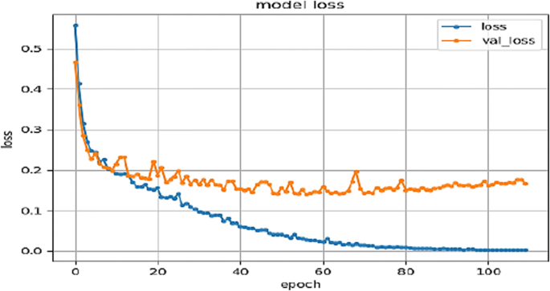
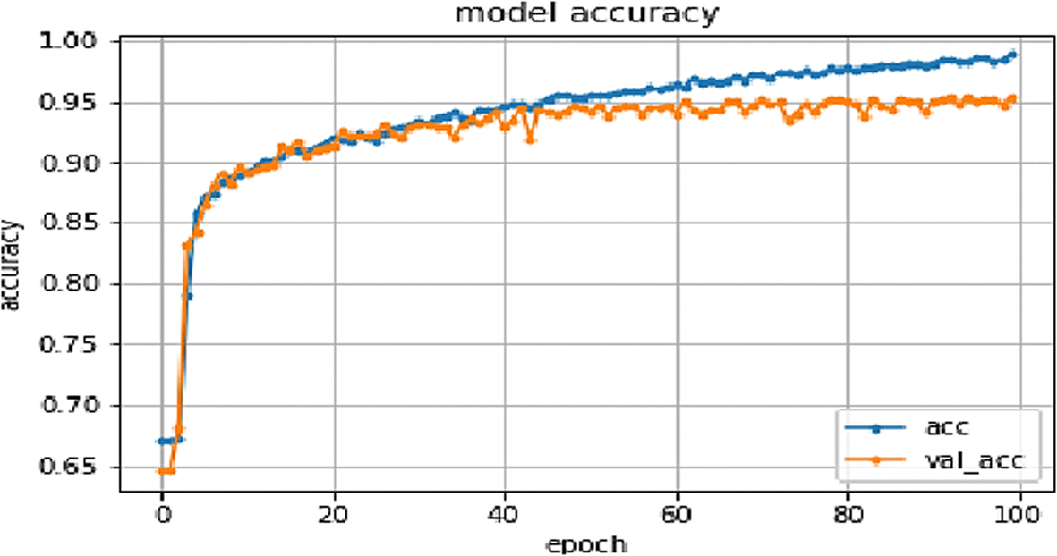
RESULT ANALYSIS
In the project, we’ll be implementing a CNN-LSTM model for classifying videos into violence and non-violence categories.
The model, with around 1.2 million parameters, would effectively trained and tested on a Raspberry Pi, using TensorFlow and Keras.
The system shall demonstrate strong performance, achieving high accuracy, recall, and precision, while effectively handling diverse video content.
Key to its success would be the use of MobileNetV2 for feature extraction and LSTM for temporal analysis.
Results may show robust performance, with a high accuracy rate, despite variations due to video quality and content complexity.

Slide 18
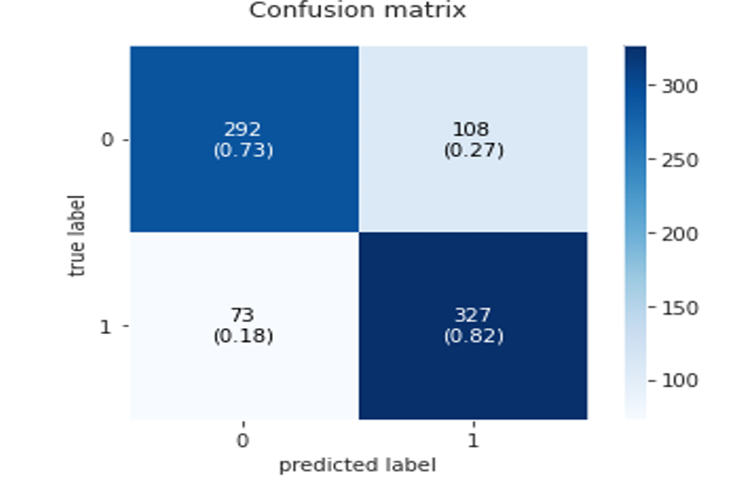
Confusion matrix of the proposed CNN model using the proposed approach

Slide 19
FUTURE WORK
1. Enhanced Model Architecture: Explore advanced neural network architectures or hybrid models to
improve classification accuracy and robustness, potentially incorporating attention mechanisms or transformer models.
2. Expanded Dataset: Augment the dataset with more diverse and high-quality video samples, including different environments and scenarios, to improve the model's generalization and reduce false positives/negatives.
3. Real-Time Optimization: Optimize the model for even faster real-time processing and lower latency,
potentially through further model compression techniques or hardware acceleration.
4. Contextual Analysis: Integrate contextual information, such as audio and metadata, to enhance detection accuracy and provide a more comprehensive understanding of violent and non-violent events.
5. User Feedback Integration: Develop a feedback mechanism to continually improve the model based on real-world performance and user input, allowing for adaptive learning and refinement.
6. Cross-Platform Deployment: Extend the system’s deployment capabilities to other platforms and devices, ensuring compatibility and performance across a broader range of hardware configurations.

Slide 20
CONCLUSION
The real-time violence detection system using CNN-LSTM efficiently classifies videos into violence and non-violence categories, running effectively on low-cost devices like the Raspberry Pi.
By leveraging MobileNetV2 and LSTM, the model provides reliable performance despite varied video conditions.
Future work will focus on refining the model, expanding datasets, and enhancing real-time processing for improved accuracy and adaptability.

Slide 21
THANK YOU!

